Slide 1
Sarcasm Detection with Self-matching Networks and Low-rank Bilinear Pooling
ADVISOR:JIA-LING KOH
SOURCE:WWW’19
SPEAKER:LI-WEI LiU
DATA:2019/11/22
Notes:
WWW: World Wide Web

Slide 2
OUTLINE
Introduction
Method
Experiment
Conclusion

Slide 3
INTRODUCTION
What is Sarcasm?
Saying the opposite of
what you mean for the
purpose of humour or criticism.
Notes:
諷刺 ，說出的與你想表達的意思是相反且帶有諷刺意味的
通常以幽默或批評為目的。

Slide 4
INTRODUCTION
Example Sentence:
"A wonderful day of starting work at 6am" "I am working hard to be this poor" "Oh thank GOD, our entire offi email system is down“
Traditional Model
Binary classification task
Our Model
Incongruity information embedded in sentences
Notes:
傳統模型 大多只能預測2個類別的分類，以及強調比較重要的離散特徵
我們的模型 識別和利用句子中嵌入的不一致模式

Slide 5
OUTLINE
Introduction
Method
Experiment
Conclusion

Slide 6
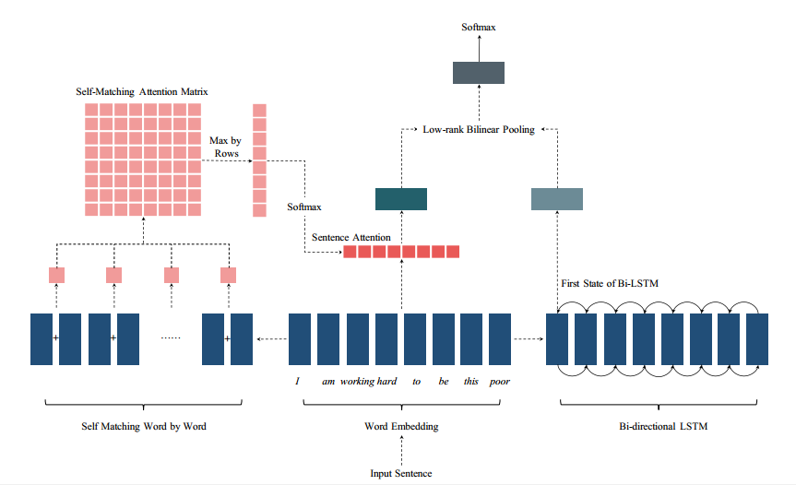
FRAMEWORK

Slide 7
METHOD
Sentence Representation:
The embedding for each word E in the sentence ,E ∈ R^{k}
For any sentence S, we build a feature map by combining its word embeddings: S = [e₁^{T} , e₂^{T} , . . . , e_{n}^{T}] ,S ∈ R^{k×n}
n : The number of words in the input sentence
n
k
I am working hard to be this poor

Slide 8
METHOD
Self-matching Network:
The purpose of our proposed self-matching network is to generate a attended feature vector for the input sentence: f_{a} = S · a
We calculate every word-to-word pair’s
interaction information w_{i,j} as:
w_{i,j} = tanh(e_{i}˙M_{i,j}˙e_{j}^{T}),
where e_{i} and e_{j} are word embeddings for i and j
and M_{i,j}∈ R^{k×k} , w_{i,j} ∈ R^{1×1}
Notes:
Self-matching Network 為了搜尋word與word之間，潛在的不一致性

Slide 9
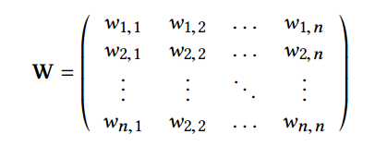
METHOD
Self-matching Network:
So, having W:
Then,calculate m ∈ R^{n} by maximizing elements in W by rows:
Notes:
Mi 對每個word 找出跟他最相關的pair(max w i,j) 當作representation
self-matching information matrix W based on all joint information

Slide 10
METHOD
Self-matching Network:
Finally,we input m into a standard softmax function to calculate a: a = Softmax(m) ,a ∈ R^{n}
So we can get f_{a}
where f_{a} = S · a
Notes:
f_{a} 之後會進入predictionn layer
指一下S跟a分別是哪個

Slide 11
METHOD
Bi-direction LSTM:
For each input sentence, we feed S into the Bi-LSTM encoder
and we defie the hidden state h at the ith time step as:
But we only adopt the fist hidden state
as the output of the Bi-LSTM encoder,so , where f_{l} ∈ R^{d}
Notes:
由於self-matching network缺乏找出句子組成訊息的能力=>Bi-direction LSTM
先介紹傳統Bi-direction LSTM
動畫跑出來的才是介紹我們使用的Bi-direction LSTM
f_{l} 進入prediction layer

Slide 12
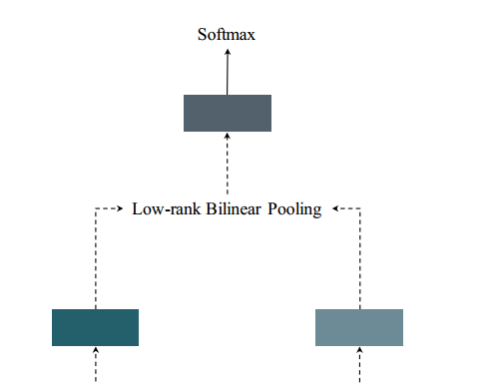
METHOD
Low-rank Bilinear Pooling:
We calculate the final projection feature vector
for the input sentence f as:
Where f ∈ R^{c} , f_{a} ∈ R^{k} and f_{l} ∈ R^{d}
f_{a}
f_{l}
A standard softmax classifiation layer:
Where P_{i} ∈ R² , W_{f} ∈ R^{2×c} and b∈ R²
Notes:
Low-rank Bilinear Pooling 對f_{a} 跟f_{l} 同時(bilinear)投影到c維上，且用Hadamard product來計算潛在的訊息加成
U^{T} ∈ R^{c*k} V^{T} ∈ R^{c*d} g ∈ R^{c*}
Finally,we input f into a standard softmax classifiation layer to make the sarcasm prediction:

Slide 13
METHOD
Training Objective:
Loss fuction(Standard cross-entropy loss fuction):
N=The size of training datasets
θ = {M_{i} _{, j} , U, V, g, W_{f} , b}
R = ∥θ∥L2

Slide 14
OUTLINE
Introduction
Method
Experiment
Conclusion

Slide 15
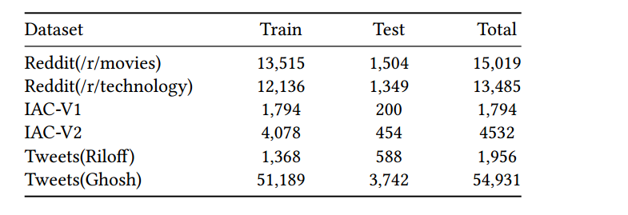
EXPERIMENT
DataSets:
We fix the length of input sentence↓
20
60
20
Notes:
短 Reddit 如上述資料 分 電影跟技術
長 IAC 線上辯論論壇，裡頭的政治辯論
短 Tweets 類似部落格 紀載著各種文章

Slide 16
EXPERIMENT
Experimental Settings:
1.Pre-process datasets
2.Parameter setting:
Learning rate=0.01
Epochs=200
Batch size={64,256,512}
k=100
d=100
c=100
Notes:
會做前處理-移除只出現一次的字、移除超連結、低於5個字的句子
介紹他實驗的參數

Slide 17
EXPERIMENT
Experiment results on Reddit datasets:
Notes:
此表格強調SMSD跟SMSD-BiLSTM都比以往的模型好 (以下註解為model介紹)
NBOW 將句子的embedding 做平均 來當作他的representation
ATT-LSTM LSTM with all hidden states in attention
GRNN bi-directional gate RNN
CNN-LSTM-DNN 2層CNN+1D 卷積層 + 2層LSTM 來做處理feature 最後+1層DNN輸出預測
SIARN and MIARN single-dimension intra-attention network /multi-dimension intra-attention network. 可以很好的捕捉不一致的字
((Attention(Query、key、value) intra-attention=Self Attention

Slide 18
EXPERIMENT
Experiment results on IAC datasets:
Notes:
動畫1 在IAC-V1 雖然MIARN的recall最高，但作者的model在其他分數還是高於它，且SMSD-BiLSTM都是最高的
動畫2 在IAC-V2 雖然MIARN的recall、accuracy最高，但作者的model在Precision、F1高於它。
動畫3 綜合來看，作者的2個model穩定度都較高，觀察在2個資料集的acc

Slide 19
EXPERIMENT
Experiment results on Tweets datasets:
Notes:
秀這個圖主要講，在Tweets(Riloff)的資料集中，作者的2個模型都達到很好的效果，但也因為該資料集數據不平衡(因為收集時是根據每個人的Github 連結) 所以預測結果都來自dominant class(根據極其準確的類別)
Tweets(Ghosh)則是收集不完全

Slide 20
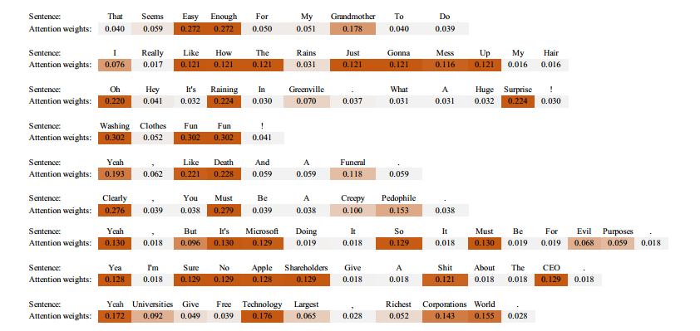
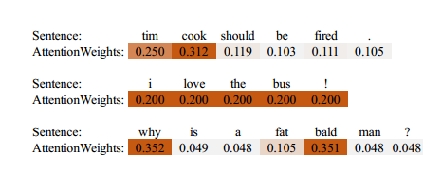
EXPERIMENTVisualization of Self-matching Results
Notes:
第一個結果圖顯示他找到的為準確的self-matched attention weight的例子
第二個圖為失敗圖:
Tim cook這句失敗原因:需要額外的知識，才懂他的嘲諷意義
第二句失敗原因:單從這句，無法得知我其實是討厭bus的
第三句失敗原因:這個例子為反問句，因為修辭的問題導致。

Slide 21
OUTLINE
Introduction
Method
Experiment
Conclusion

Slide 22
CONCLUSION
The self-matching network allows us to capture the interaction between words to search for potential conflict sentiments.
We also incorporate a bi-directional LSTM encoder to utilize sentence’s compositional information.
We find supportive empirical evidence on utilizing sequential neural networks and low-rank bilinear pooling method can help improve sarcasm prediction result.
Notes:
potential conflict sentiments:潛在的帶有衝突的情緒
sentence’s compositional information:句子的組成信息

